Slide 1

The Opioid Abuse Predictor
An RNN-based screening tool to predict opioid abuse prior to opioid prescription
Students: Morgan Durham, Srimann Ramachandruni, and Tom Lever
Mentor: Heman Shakeri
08/02/2023

Slide 2

The Opioid Epidemic
1995
2007
2011
2023-
Drug Approval
Purdue is Fined
Tripling Effect
Present Day
Purdue Pharma is permitted to sell oxycontin to prescribers
Purdue Pharma is fined $634 million for lying about the harmful effects of the drug.
Opioid prescriptions triple between 1991 to 2011.
Tools have emerged, such as the ORT, that try to combat against the abuse of the drug
Notes:
Purdue Pharma was a pharmaceutical company, it is has ceased all operations in Sept. 2021, but in 1995 it received approval from the FDA to release oxycontin as a pain management. Labeling said it was non addictive which allowed prescribers to give to patients for all types of pain, not just chronic. So if a patient had a headache, rather than prescribe ibuprophen, a patient could be prescribed oxycontin
Although effective, the adverse effects of opioids, such as dependence, abuse, and poisoning, have resulted in 130 deaths of Americans daily and impose significant financial and resource burdens on the healthcare system. Since approximately 91.8 million (37.8%) civilian non-institutionalized adults in the United States consumed prescription opioids in 2015 and 13.5 million (5.5%) of them had some form of opioid misuse, determining individuals who are at an increased susceptibility to these conditions is essential for responsible pain and system management (Han et al. 2015)

Slide 3

Previous Research
Deaver et al. built an opioid abuse predictive model including factors such as depression, alcoholism, immunization history, and medications such as natural Opium Alkaloids and phenylpiperidine derivatives (Deaver et al.).
Dong et al., built “machine learning based prediction models to predict opioid overdose of patients based on the history of patients’ electronic health records”

Slide 4
Purpose of the Opioid Abuse Predictor
Focuses on prediction of opioid abuse prior to prescription
Harness time-series-based data to make more informed decisions when evaluating patients for potential opioid abuse
Patient’s time series as matrix of events
Probability that patient will abuse opioids
Time of Lab Results
Time of Diagnosis
Time of Procedure
Time of First Opioid Prescription
Time of Opioid Abuse Diagnosis
Notes:
Mention opportunity here, and previous research

Slide 5
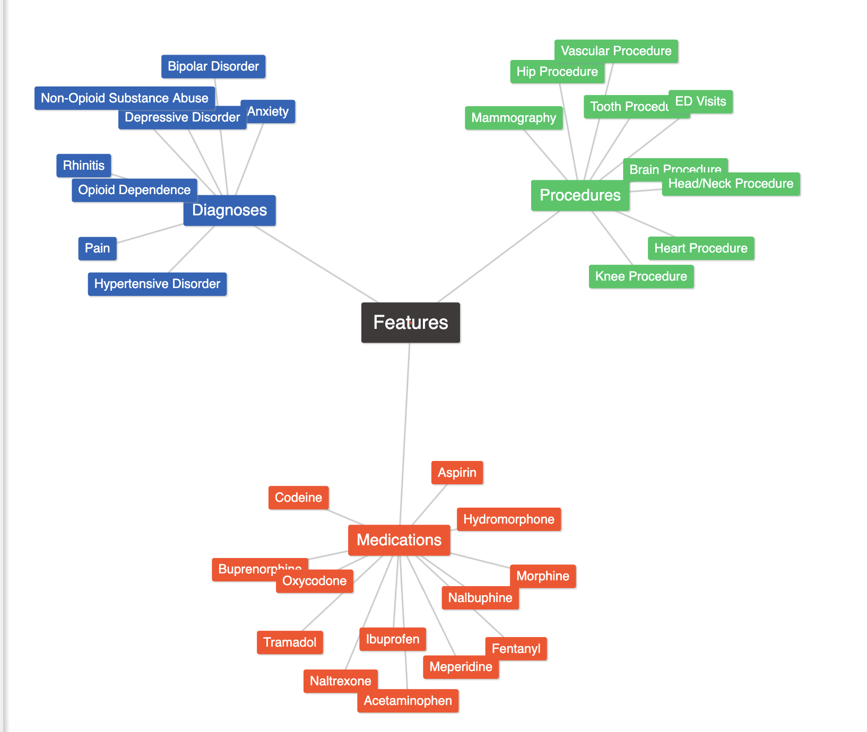
Cohort and Feature Selection
Cohort includes ~4896 patients, without cancer and with at least one opioid prescription in their medical history
Features identified through previous literature, All of Us Cohort Reviews, consulting physicians

Slide 6
Generating Feature Matrix
All of Us Health Database
Workbench-Generated SQL Queries
Feature Matrix constructed through series of left joins
Workbench Generated SQL Query #1
Table of visit occurrences for cohort
Workbench Generated SQL Query #2
Table of positive indicators of opioid abuse
Workbench Generated SQL Query #3
Table of positive indicators of opioid abuse
Feature Matrix
Workbench Generated SQL Query #4
Table of positive indicators of anxiety
…
…

Slide 7
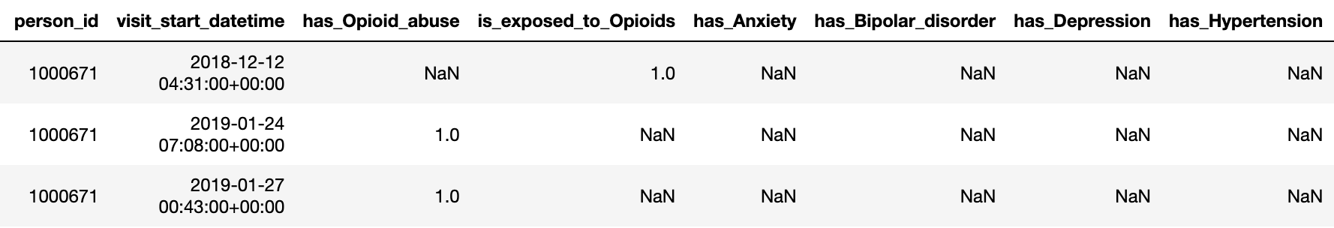
Patient Level Data
Extraction From Patient Level Dataframe
Notes:
Patient Level data is now ready for machine learning

Slide 8
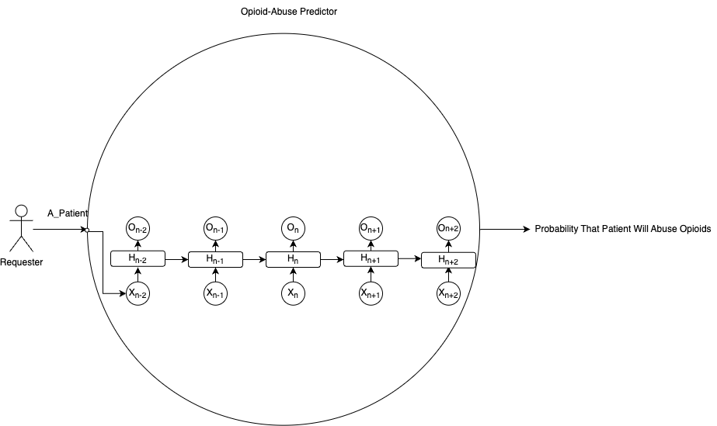
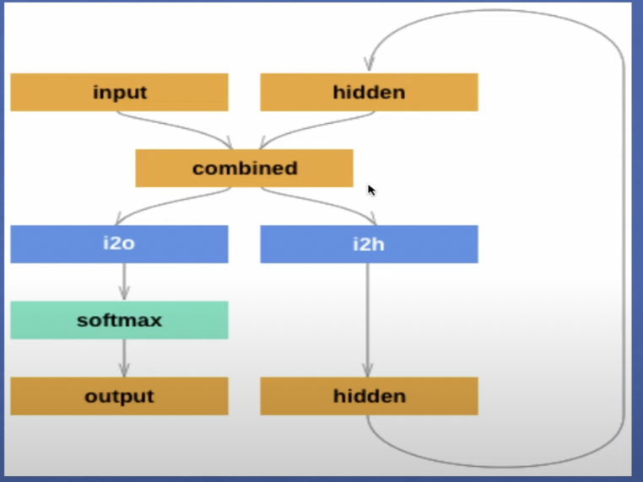
Building RNN and Generating Output
Hidden states confer RNNs with the ability to “remember” past information
Linear Layer #1 (i2o) and Linear Layer #2(i2h) generate an output and updated hidden state, respectively

Slide 9
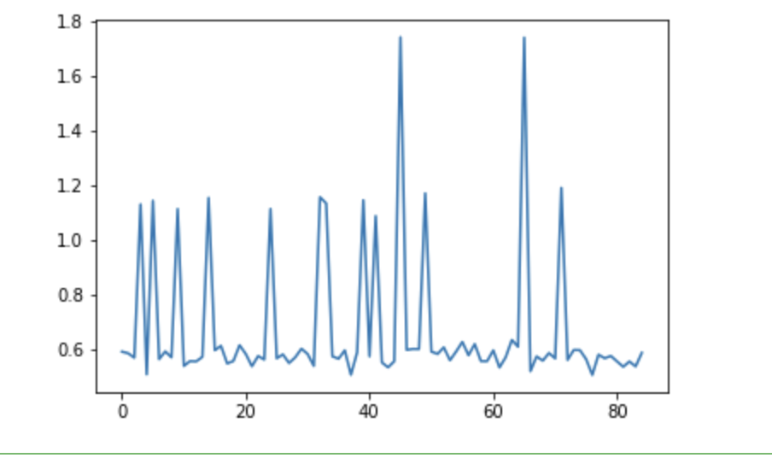
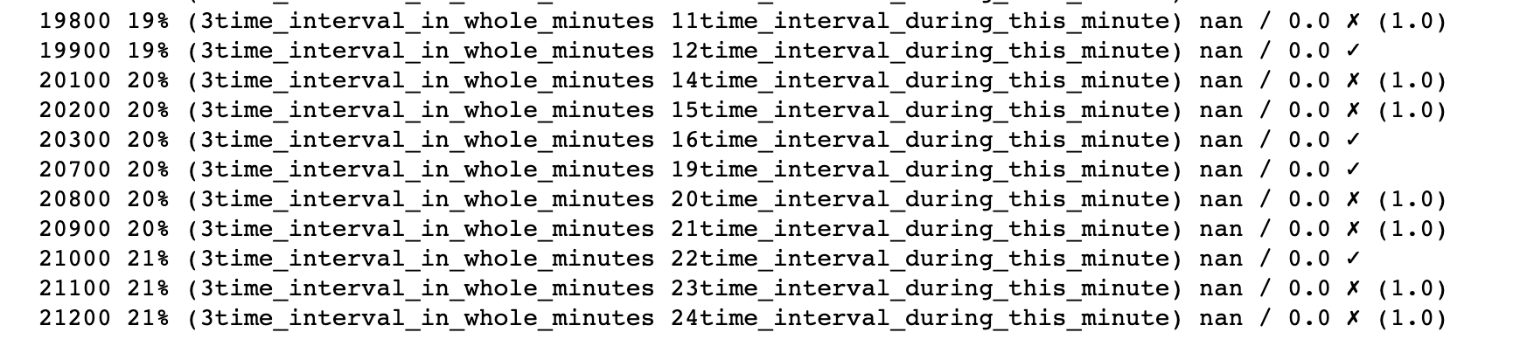
Results
Model failed to converge
Exploding/Vanishing gradient
Data Sparsity
Notes:
Explain why we saw these results, why we were unsuccessful
Using gradient clipping, LSTMs, GRUs,

Slide 10
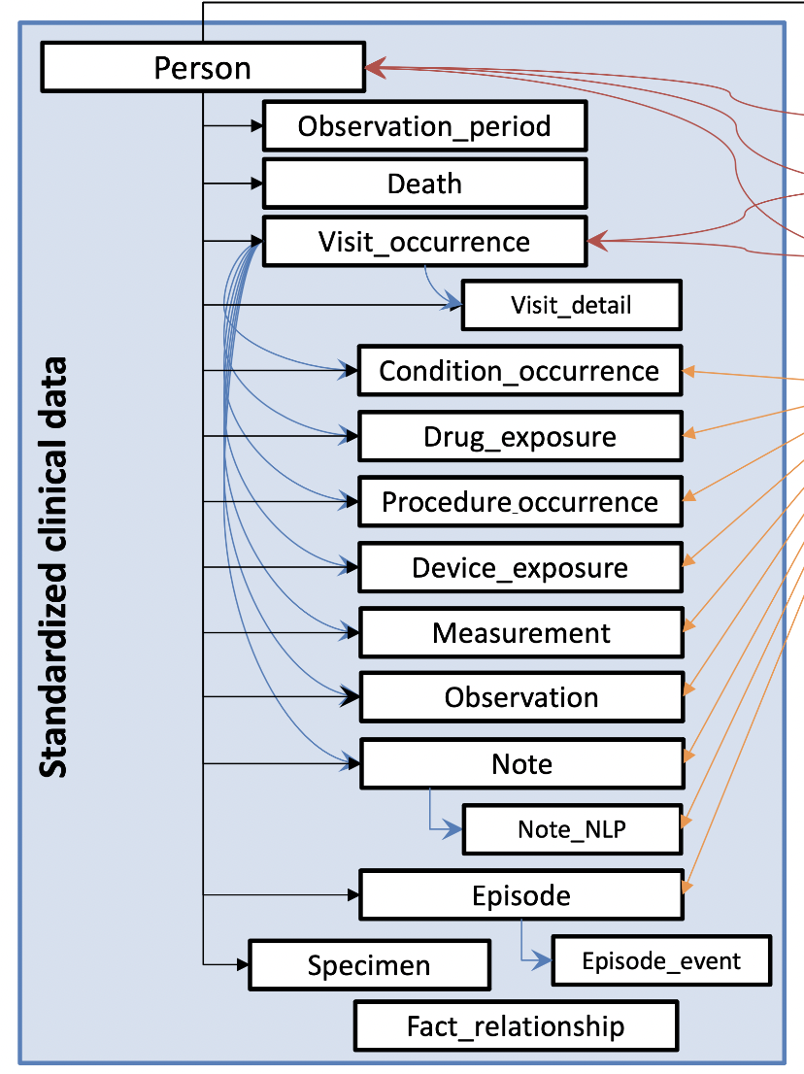

Challenges
Working with NIH All Of Data
Feature Selection
Data Sparsity
Notes:
Challenges of working with NIH database, talking about all the different tables
Explain why we saw these results, why we were unsuccessful

Slide 11
Future Research
Consider other imputation techniques such as introducing “tails” and extending positive indicators
Develop an autoencoder to process the feature matrix with relatively few columns and rows; consider other mathematical dimensionality reduction techniques such as UMAP, tSNE, PCA, and FA
Consider variations of RNN architectures, mainly GRUs and LSTMs, which resolve vanishing/exploding gradients

Slide 12
Acknowledgements
We would like to express our sincerest gratitude to the University of Virginia as well as all individuals who contributed to the development and presentation of this project. Additionally, we would like to thank Dr. Heman Shakeri for allowing our team to continue his tremendous work.

Slide 13

Questions?

